Slide 1

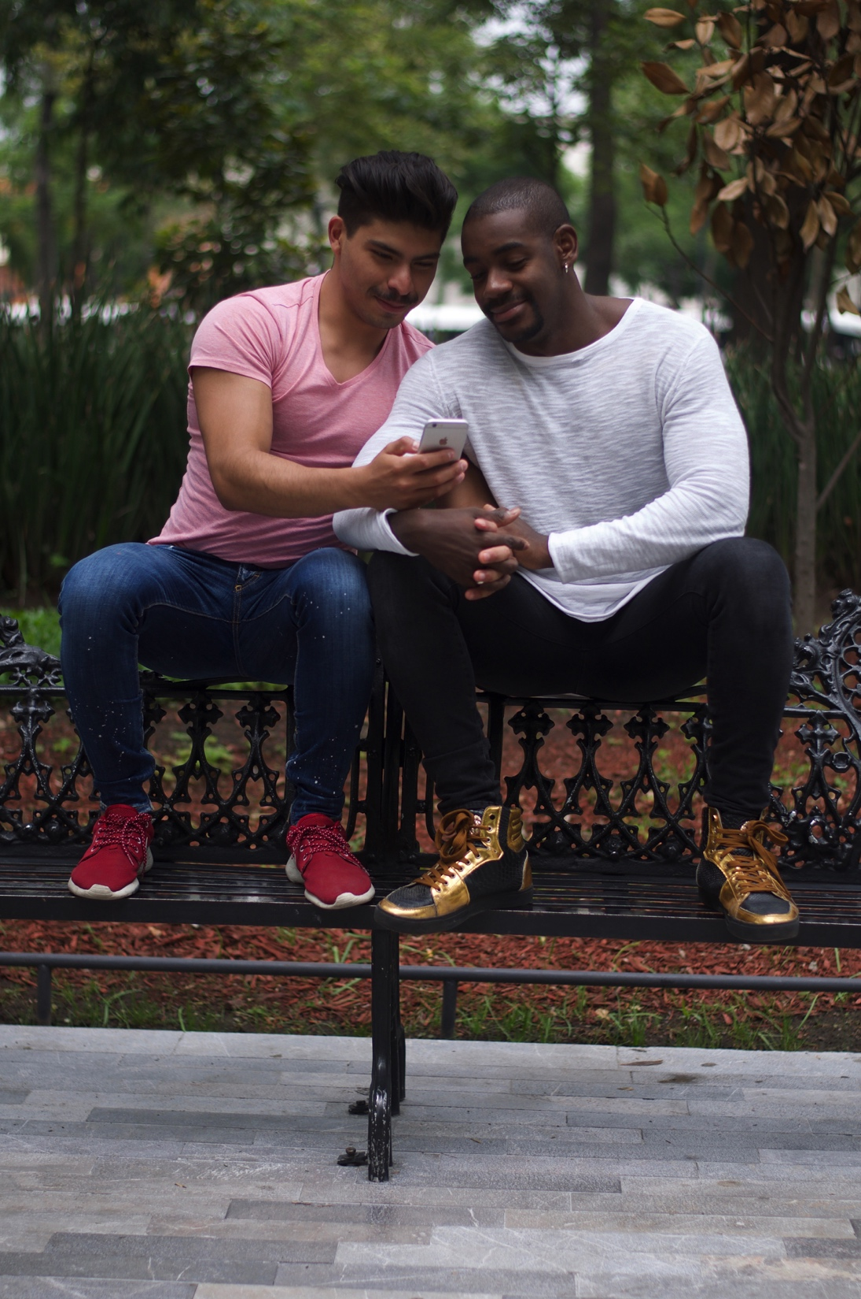
Queerly Connected:
Partnering with apps to improve gay men’s health
Alex Garner
Senior Health Innovation Strategist

Slide 2

KYS

Slide 3

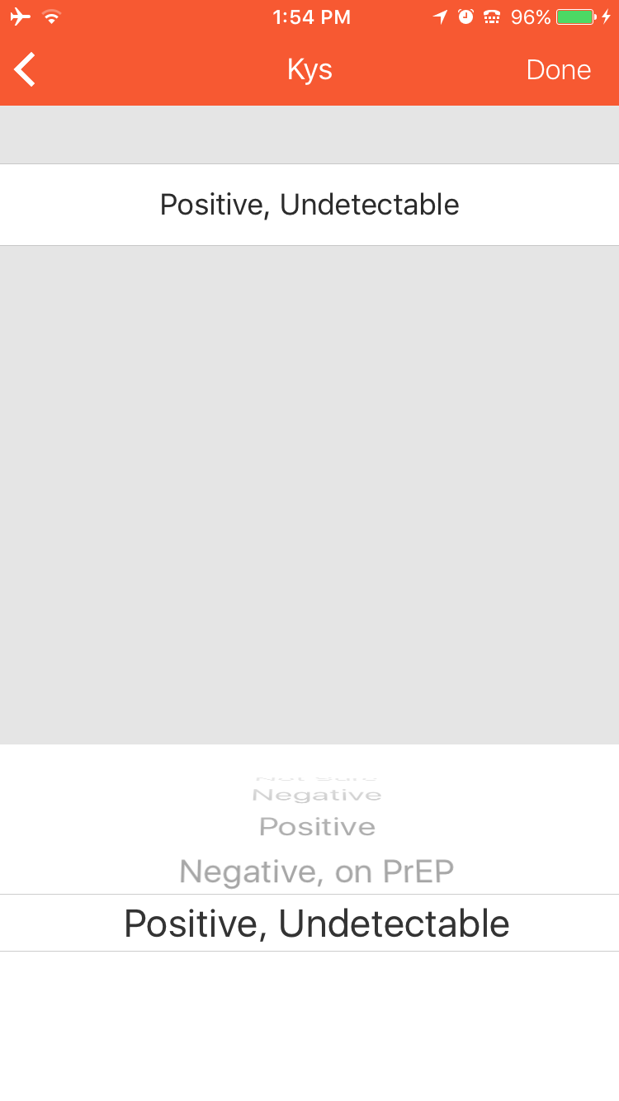
KYS

Slide 4
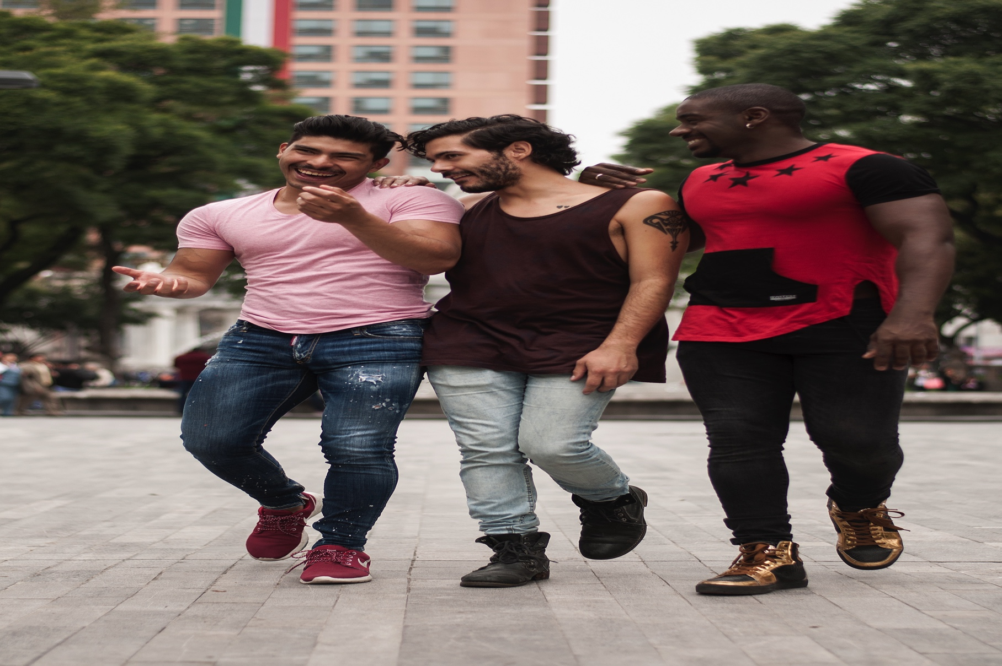
Engagement with online social networks is daily.
Interactions with health system is 3 to 4 times a year
Online is holistic approach to complex lives of gay men
Health Ambassaor

Slide 5
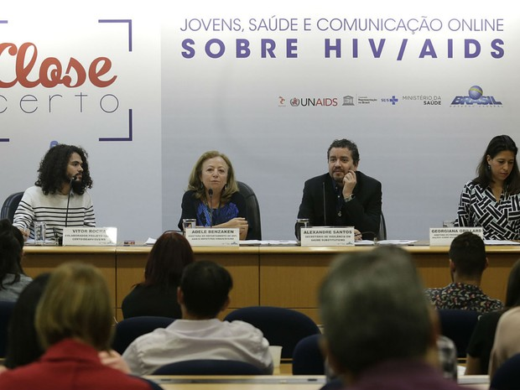

Rio de Janeiro Olympics 2016
Notes:
18 HA & over 1000 chat messages

Slide 6


May-August 2019
Internet sampling method to conduct cross-sectional survey recruiting LGBTI participants
Objective: to examine how various demographic, economic, socioecological, homophobic, psychosocial, attitudinal and behavioural variables potentiate HIV risk behaviour
LBTI have a good social support network (79%), but only 54% enjoy support from their family or social support.
Only 32% are out to most people they know 54% must hide their true nature more of the time, if not all the time.
74% would like to have more sex
HIV prevalence is high
There is a concern in terms of access to treatment and viral load testing.
9% of LGBTIs living with HIV are not accessing treatment,
18% are not virally suppressed,
54% of LGBTI living with HIV are additionally confronted to HIV stigma.
Global LGBTI Happiness Study
Notes:
18 HA & over 1000 chat messages

Slide 7


Health Ambassador Program
Peer to Peer Engagement
Health Ambassaor

Slide 8
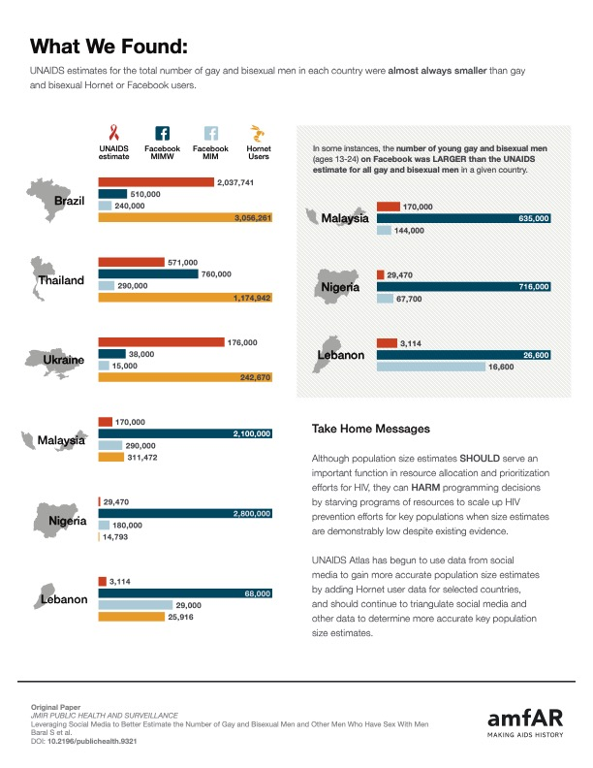
Health Ambassaor

Slide 9
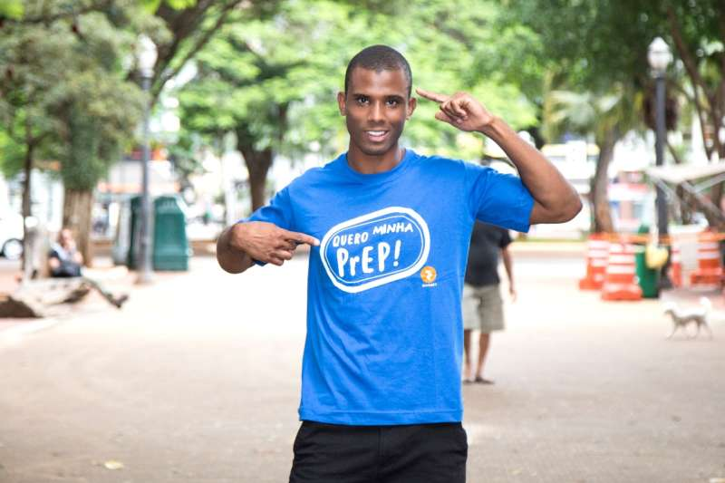
Leverage platform:
Increase demand
Mobilize
Prioritize gay men’s health
Data to inform policy and programs

Slide 10

Thank you!
Alex Garner
Alex.Garner@Hornet.com

